Slide 1
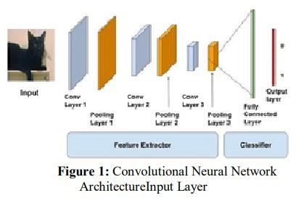
Selected-2 Paper Presentation
1.Architecture used in the paper:
Convolutional neural Network has hidden layers, Known as Convolutional layers which make CNN more effective for image analysis. CNN layer types mainly include three types [14] as shown in the Figure 1: ∙ Convolutional layer ∙ Pooling layer ∙ Fully connected layer When a computer sees image, it converts the image into an array of pixel values depending on the
image resolution and size. Let’s consider an image of type of jpg and size be 480 x 480. Then its converted to 480 x 480 x 3 image where the represents the RBG values[23]. To describe the intensity of the pixel [15], they are given numbering from 0 to 255. Further the array with numbers are given as input to the image classification.

Slide 2
Dataset Details:
The CIFAR-10 data consists of 60,000 32x32 color images in 10 classes, with 6000 images per class. There are 50,000 training images and 10,000 test images in the official data. We have preserved the train/test split from the original dataset. The provided files are:
train.7z - a folder containing the training images in png format test.7z - a folder containing the test images in png format trainLabels.csv - the training labels
To discourage certain forms of cheating (such as hand labeling) we have added 290,000 junk images in the test set. These images are ignored in the scoring. We have also made trivial modifications to the official 10,000 test images to prevent looking them up by file hash. These modifications should not appreciably affect the scoring. You should predict labels for all 300,000 images.
The label classes in the dataset are:
airplane
automobile
bird
cat
deer
dog
frog
horse
ship
truck
The classes are completely mutually exclusive. There is no overlap between automobiles and trucks. "Automobile" includes sedans, SUVs, things of that sort. "Truck" includes only big trucks. Neither includes pickup trucks.

Slide 3
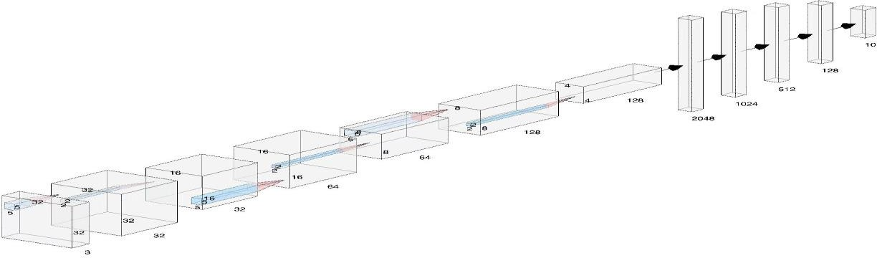
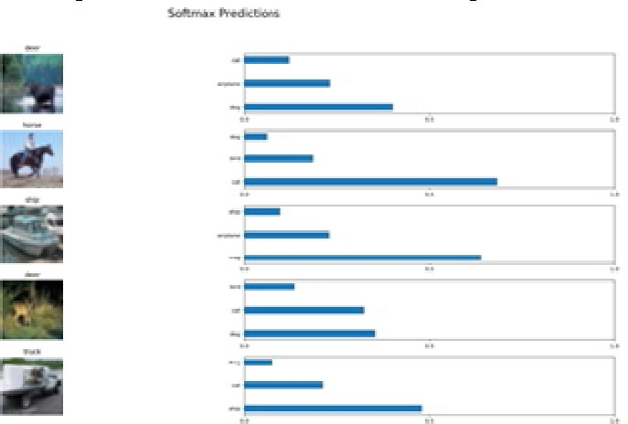
Implementation Details:
Convolutional Neural Network (CNN)
Results and Visualizations
Convolutional Neural Network (CNN) is used for image classification which contains Convlayers to extract features and max pooling to decrease the size of image thus classifying the image accurately. It’s implemented using the CIFAR-10 dataset in python
Out of which 50000 are training images and the remaining 10000 are testing images. The figure below is the output of the CNN for Cifar-10 with Epoch size 2.

